Slide 1
Chest Seal Use & Training
Notes:
This presentation was developed by the Central Texas Regional Advisory Council and the Heart of Texas Regional Advisory Council in concert with our regional trauma physicians and leaders. It is for use exclusively in school districts in Trauma Service Area L & M. This is intended to address HB 496 that indicates chest seals are required equipment in a school’s bleeding control kits.
Counties: Bell, Coryell, Milam, Lampasas, Hamilton, Mills, Falls, Limestone, Hill, Mclennan, Bosque

Slide 2
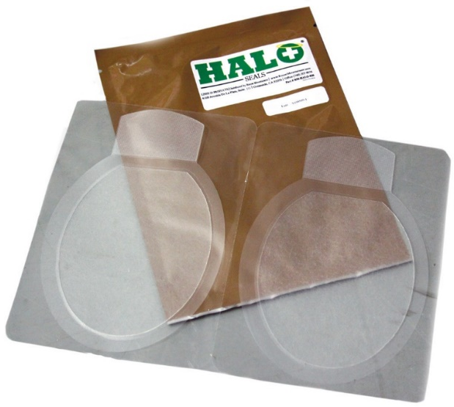
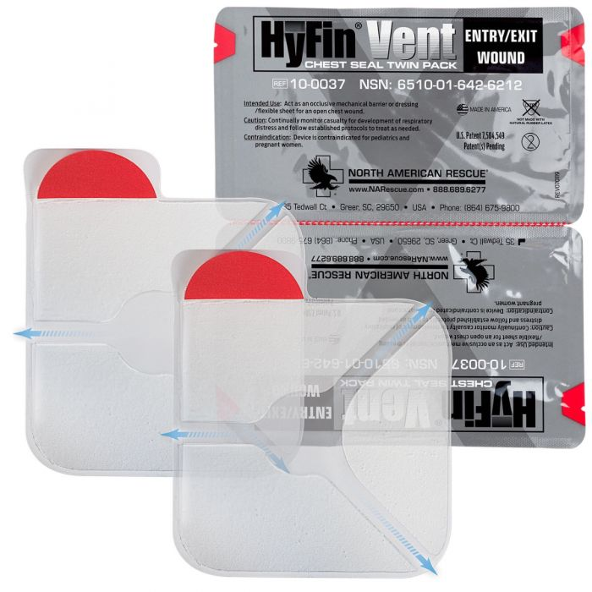
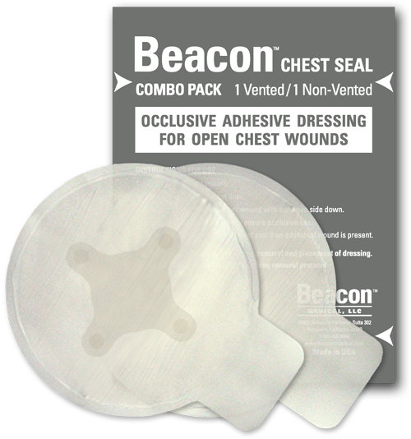
What is a chest seal?
A clear bandage with strong glue
used for chest wounds
Notes:
Be sure to avoid discussing vented versus non-vented. The emphasis should remain on the fact that it is a bandage for use exclusively on chest wounds. Bleeding events on any other part of the body should be referred back to Stop the Bleed ABCs.
There are various brands of chest seals and they have some differences like size and shape. Refer to images.
Suggestion: Try asking the audience, “Where do you place a chest seal?” It should be obvious in the name and stating it out loud will remove ambiguity.

Slide 3
Use a Chest Seal on a chest wound
Air: If you hear air.
Bubbles: If you see or hear bubbles.
Chest seal
Remember that injuries to the body:
Can be on the front, back, or sides of the chest.
May have more than one opening in the chest if due to gunshots.
Notes:
Instructors should avoid medical terminology. Anatomy figures were omitted intentionally to avoid confusion or “assessments” based on extraneous information.
If bleeding is present, refer to Stop the Bleed ABCs.

Slide 4
Steps to apply a chest seal
Dry the skin if possible around the wound.
Center the sticky side down over the wound (i.e. hole).
Apply and press the chest seal to the skin.
Source: narescue.com
Notes:
Chest seals currently available in the region are vented. Non-vented chest seals should not be a part of the training. As such, there is no need to discuss “burping” or needle decompression.
Any further “assessments” may lead to confusion. Avoid any clinical algorithms.

Slide 5
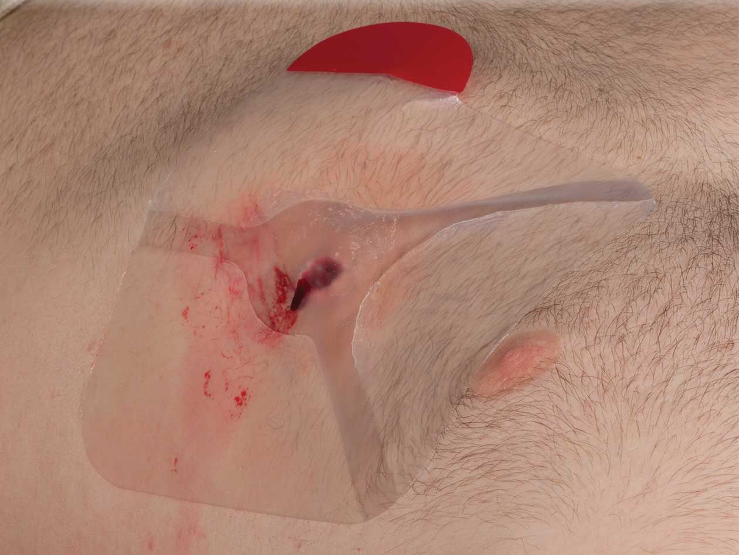
Steps to apply a chest seal
Dry the skin if possible around the wound.
Center the sticky side down over the wound (i.e. hole).
Apply and press the chest seal to the skin.
Source: narescue.com
Notes:
This image represents the chest seal being centered over the wound. While vents are visible here, there is no need to address. Red tab on chest seal is specific to this brand. It may not be present on chest seal in their kits. All vented chest seals operate in the same way. Slide 2 shows how chest seals can come in different shapes, sizes, and look.

Slide 6
Thank you for your participation!
Questions?
Notes:
For instructors only:
Answer questions using the Stop the Bleed ABCs or the chest seal ABCs.
For example, “What if the person’s organs are hanging out of their body?” This is not addressed in either presentation. Actions beyond the scope of these presentations are likely beyond the scope of the participants.
Training, school, degrees, and professions exist that can address complex medical emergencies. Some injuries are beyond field interventions by the lay person.

